Slide 1

REVENUE REPORT
FOR DTLM RETAIL
JANUARY – MAY 2024
PRESENTED BY: TEAM 4
OLUWASEYI FOLORUNSO
SENAMI AGUNBIADE
ISRAEL ADEGBILE OLUWAGBEMI
JUNE 2024.

Slide 2

CONTENTS
01
Overview
02
Revenue Trend
03
Top 5 Product by Revenue
04
Top 10 Sales Team by Revenue
05
% Revenue Contribution of Product Category
06
Top 10 Sales Team by Revenue, Store Count, Median Income and Population.

Slide 3



OVERVIEW
This report evaluates the company’s financial outcomes from January through May 2024. The analysis covers revenue, profit margins, product sales performance, and Sales team contributions.
This report highlights key metrics such as the revenue trend, the top 5 products by revenue, the top 10 sales teams by revenue, revenue contribution (%) of the product categories, and the top 10 states by revenue, also showing their population, median income and store count per state
This report's analysis was conducted using Microsoft Excel. Key business metrics were derived through various calculations to inform decision-making processes.

Slide 4
Within a 5-month time frame, the total revenue obtained was $44,365,028.03.
The highest revenue obtained is $9,177,056.77 which was recorded in May.
The least revenue obtained is $8,557,316.37 occurred in February.
REVENUE TREND

Slide 5
There are exactly 47 different products sold by DTLM in the United States.
5 of 47 products ranked as Top 5 based on the revenue generated.
Revenue from Clock was massive, followed by Vases, Cookware, Ornaments, and Phones
TOP 5 PRODUCT BY REVENUE

Slide 6
10 out of 28 team displayed outstanding performance on basis of revenue generated.
Total revenue by the top 10 team sum up to $17,614,881.52 million USD.
Overall, Team Nicholas Cunningham is the best performing team by revenue.
TOP 10 SALES TEAM BY REVENUE

Slide 7
The product category “Decoratives”, returned the highest percentage revenue contribution.
Categories with revenue contribution < 10% include all except Decoratives, Furniture and Kitchenery.
% 5 PRODUCT BY REVENUE

Slide 8
A strong positive correlation exist between revenue, Store count and Median Income.
Population proved to be a less significant determinant factor for income generation e.g. New York.
California is the highest revenue generating state with the highest store count and Median Income.
TOP 10 SALES TEAM BY REVENUE

Slide 9
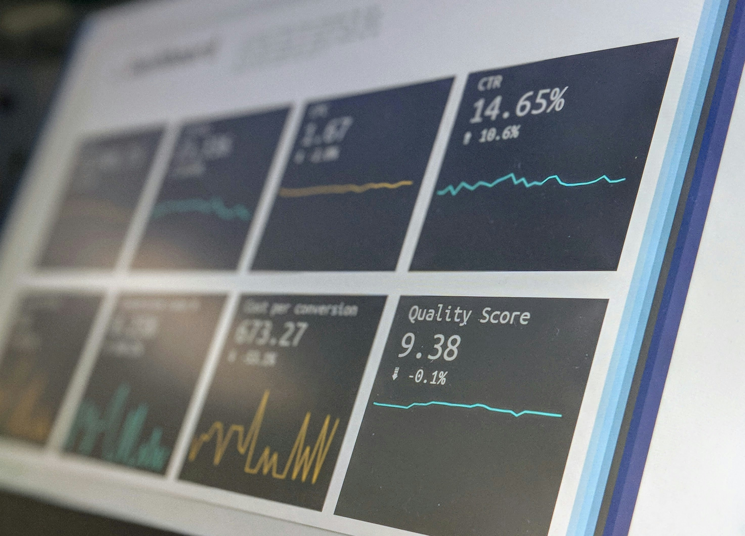

CONCLUSION
From our analysis, we project a increasingly upward trend for our revenue on a month basis. Indicating both increase and decrease in revenue for the remaining months in 2024.
The result obtained provided valuable insights into the product performance and revenue at DTLM.
Therefore, it is important that strategic steps be taken to employ this actionable insights to make informed decision with the adoption of KPI to measure progress most especially for low performing products and teams.

Slide 10



RECOMMEN-DATION
Adoption of reward mechanism, will help to foster competition amidst sales team and drive more sales. More so, promo sales, discount, gift and vouchers should be provided to customers as a medium of attraction.
More stores should be established or set up to increase accessibility in regions with a good median income.
In addition, Sales team members should be properly trained on good customer relation as this can help retain customers.
Adoption of good marketing strategy to drive awareness of low performing products and store availability within proximity. Accessing the company's’ strength, weakness, threat and opportunities then implementing right actions.

Slide 11

THANK YOU

